Slide 1
LG Inform Prototype:
Presentation to the
Local Public Data Panel
Juliet Whitworth
Research and Information Manager
17 January 2012
www.local.gov.uk

Slide 2
Context - a different accountability
Abolition of much of the former national inspection framework
Stronger local accountability to citizens: transparency and openness
Reducing burdens: no national indicator set but still numerous data collections with 10,000s of data items
Establishing what data councils and communities want themselves: driving our data agenda
To help tell the local story for citizens and business
Desire to be sector-led

Slide 3
What is LG Inform Prototype?
Easy access to a wide range of performance and contextual data across a number of services and themes
Analysis and presentation tools to support councils in comparing data
A series of ready made reports and dashboards
Flexibility to develop, modify, view and export data and reports to suit your local requirements

Slide 4
LG Inform: Learning Group
Barnsley
Chief Fire Officers Association
Dorset
Durham
Essex
Harlow
Hampshire
Kettering
Lewisham
Merseyside Fire and Rescue Service
Stockport
Notes:
The learning group authorities were selected not only because of interest in this area, but also to get a mix of types/ size/ geographical location and political mix, to ensure that when it is rolled out more widely other authorities feel that it would be something they would use as their needs will have been taken into account in the prototype development.
They are helping us develop the tool, and providing user testing and feedback.

Slide 5
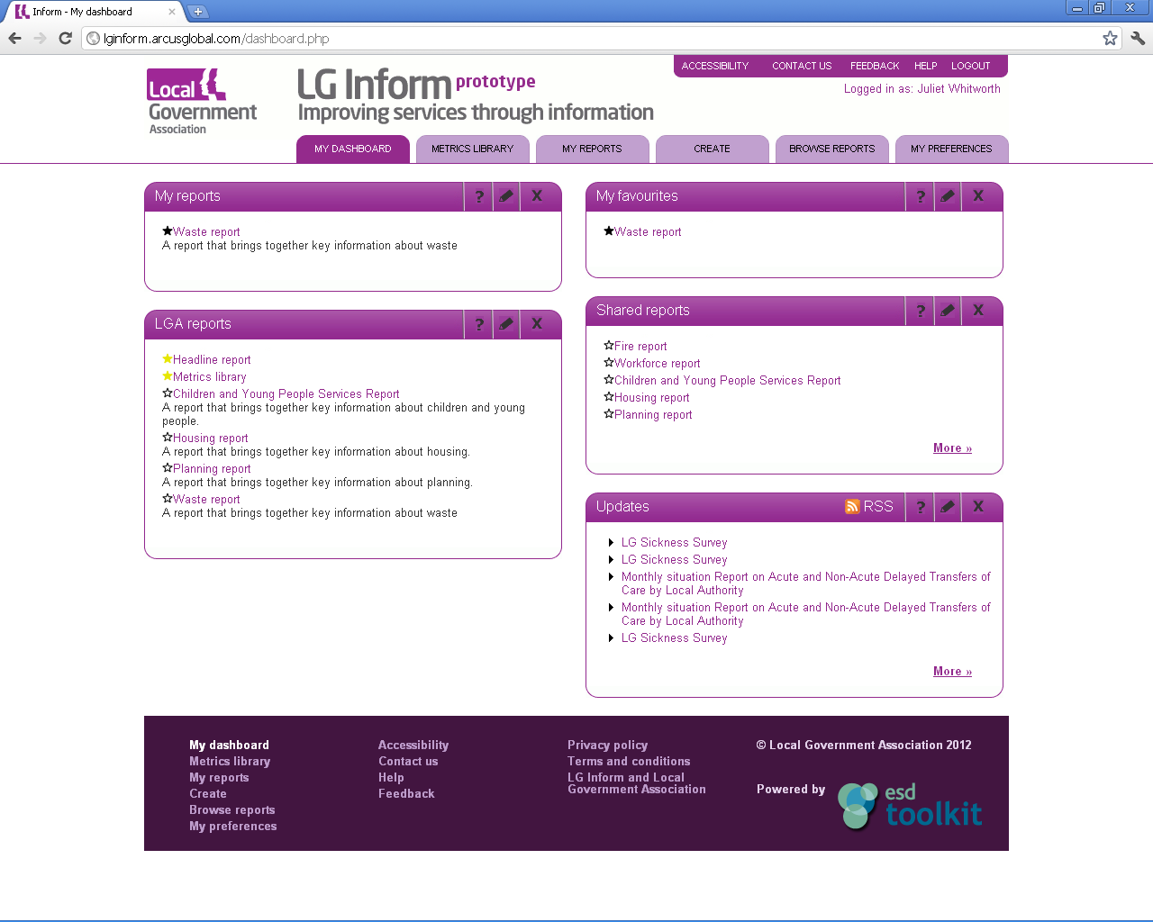
Notes:
What does it look like?
This is the landing page: Dashboard, My reports, Browse Reports, Create, Metrics Library & Preferences……How does it work? In the metrics library you can pull out one of over 700 and get the detail.
Here’s how information can be generated via the metrics library…<go to live demo>

Slide 6
What is LG Inform Prototype Plus?
Everything that is in the prototype in a matured and refined platform which is both highly responsive and intuitive to use, plus:
  an additional level of personalisation
  a system that will support a range of dashboard formats which are configurable by users
  a system which includes key aspects being open to the public
  a system that is capable of integrating with third-party sites
  ability to input and share your own data for comparable metrics

Slide 7
Overall timetable
Contract awarded – 8th February 2012
Project commences – 10th February 2012
Specifications and requirements agreed – end February 2012
Development starts – March 2012
Final development completed – August 2012
Prototype Plus full release – September 2012

Slide 8
LG Inform: feedback
Web site: www.local.gov.uk/lginform
Email: LGInform@local.gov.uk
Telephone: 020 7664 3217
For additional information and getting started: www.local.gov.uk/about-lginform

Slide 9
Questions

